Slide 1
Usage Funnels with
Warby Parker
Analyze Data with SQL
Maria Rochel Rebutar
June 18, 2023

Slide 2
QUESTIONS
In this analysis, we will answer the following questions:
What are the survey questions?
How many users move from one question to another?
Are users with more pairs to try on more likely to make a purchase?
Which model has the most purchase?

Slide 3
Analysis

Slide 4
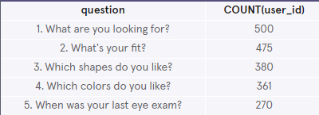
1.1 Survey Questions
To help users find their perfect frame, Warby Parker has a Style Quiz that has the following questions:
“What are you looking for?”
“What’s your fit?”
“Which shapes do you like?”
“Which colors do you like?”
“When was your last eye exam?”
The users’ responses are stored in a table called survey.

Slide 5
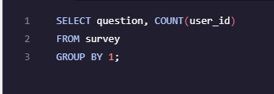
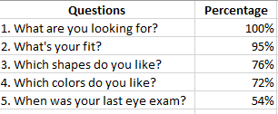
1.2 Survey Questions
As we can see in the query results, not every user completed the questions. This could be because they aren’t sure of their preferences, forgot their last exam or did not have an eye exam prior to purchase.

Slide 6
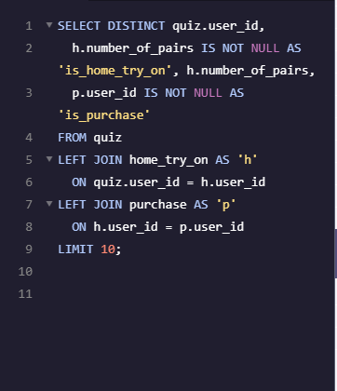
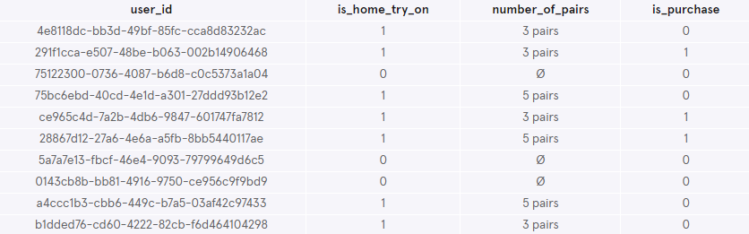
2.1 Home Try On to Purchase
50% of the users will get 3 pairs to try on.
50% of the users will get 5 pairs to try on.
Let’s find out whether or not users who get more pairs to try on at home will be more likely to make a purchase.

Slide 7
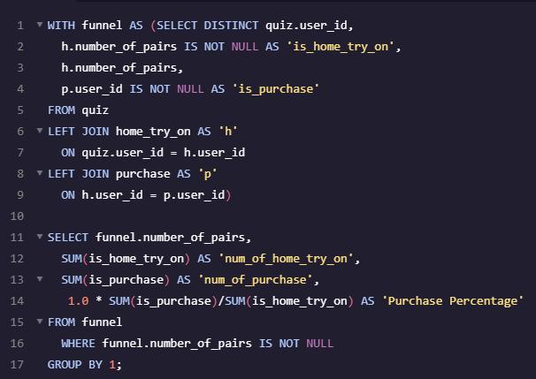
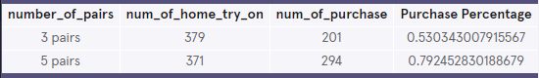
2.2 Home Try On to Purchase
Users who have 5 pairs of home try on are more likely to purchase with purchase percentage of 79% compared to 3 pairs with only 53%.

Slide 8
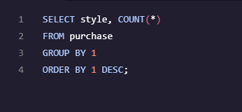
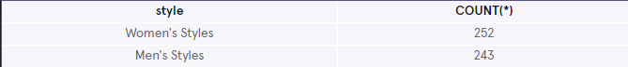
3.1 Most Purchase (Style)
Let’s check which style has the most purchase.
Women’s Styles has the most number of purchase totaling 252, although it is not that much difference compared to Men’s Style with 243 total purchase.

Slide 9
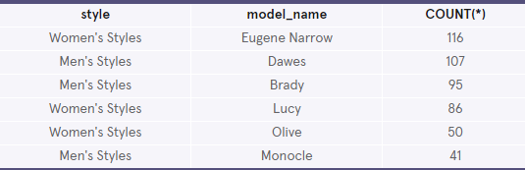
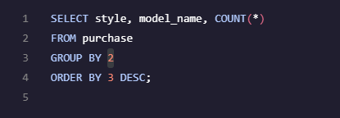
3.2 Most Purchase (Model)
Let’s check which models have the most purchase.
Eugene Narrow and Dawes has the most number of purchase for Women’s and Men’s style, respectively.

